Slide 1
ECII/ECSI/ECCI 2208: DATA COMMUNICATION TECHNOLOGIES
INTRODUCTION TO DATA COMMUNICATIONS

Slide 2
Introduction to data communication
Information: A general term that refers to symbols or signals used to convey meaning.
Data Communication: The process of transferring information between two entities at different points in a form, which can be handled by data communications equipment.
Today, data communications is often referred to as computer communication because computers, or computer peripheral devices such as a printer or VDU terminal, are usually involved.
For data communications to occur, the communicating devices must be part of a communication system made up of a combination of hardware (physical equipment) and software (programs).

Slide 3
Computer data
Familiar forms of information carried by data communication are:
Text: Alphabetic characters which includes combination small case as well as upper case. It is stored as a pattern of bits.
Numeric data: Information in the form of numbers, 0 to 9. It is stored as a pattern of bits.
Graphical data: In the form of pictures or diagram. In computers images are digitally stored.
A Pixel is the smallest element of an image. To put it in simple terms, a picture or image is a matrix of pixel elements. The pixels are represented in the form of bits.

Slide 4
Computer data
Depending upon the type of image (black n white or color) each pixel would require different number of bits to represent the value of a pixel.
The size of an image depends upon the number of pixels (also called resolution) and the bit pattern used to indicate the value of each pixel.
If an image is purely black and white (two color) each pixel can be represented by a value either 0 or 1, so an image made up of 10 x 10 pixel elements would require only 100 bits in memory to be stored.
On the other hand an image that includes gray may require 2 bits to represent every pixel value (00 - black, 01 – dark gray, 10 – light gray, 11 –white). So the same 10 x 10 pixel image would now require 200 bits of memory to be stored. Image formats: jpg, png, bmp, etc

Slide 5
Computer data
Sound/Audio:Data can also be in the form of sound which can be recorded and broadcasted. Example: What we hear on the radio is a source of data or information. Audio data is continuous, not discrete.
Video: Pictures accompanied by sound. Video refers to broadcasting of data in form of picture or movie.
Multimedia: A mixture of the different forms of information.

Slide 6
Characteristics of Data Communication
The effectiveness of any data communications system depends upon the following four fundamental characteristics;
Delivery: The data should be delivered to the correct destination and correct user.
Accuracy: The communication system should deliver the data accurately, without introducing any errors. The data may get corrupted during transmission affecting the accuracy of the delivered data.
Timeliness: Audio and Video data has to be delivered in a timely manner without any delay; such a data delivery is called real time transmission of data.
Jitter: It is the variation in the packet arrival time. Uneven Jitter may affect the timeliness of data being transmitted.

Slide 7
Elements of a data communication system
In order to communicate, there must be two entities,
  One to send the information.
  One to receive it.
Computer communication involves the following elements
  Message- information (data) to be communicate i.e. include text, numbers, pictures, audio, and video.
  Communication Equipment (hardware)
  Protocols

Slide 8
Communication Hardware
Can be classified into the following
  Data Terminal Equipment (DTE): Sources or destinations of information. Comprises of communications equipment such as terminals, host computer, printer etc.
  Data Circuit Terminating Equipment (DCE): Made up of interface devices such as the modem, switches, routers etc.
  Data communications channels: Paths through which information travels. Can be Electrical, Optical or Electromagnetic based.

Slide 9
Communication software or Protocols
Protocols
  These are standards, which allow the entities to communicate with each other.
  Protocols are therefore a set of rules precisely defining the methods used to communicate.
There are three key elements of a Protocol
1. Syntax
It means the structure or format of the data. It is the arrangement of data in a particular order.
2. Semantics
It tells the meaning of each section of bits and indicates the interpretation of each section.
It also tells what action/decision is to be taken based on the interpretation.

Slide 10
Communication software or Protocols
3. Timing
It tells the sender about the readiness of the receiver to receive the data. It tells the sender at what rate the data should be sent to the receiver to avoid overwhelming the receiver.

Slide 11
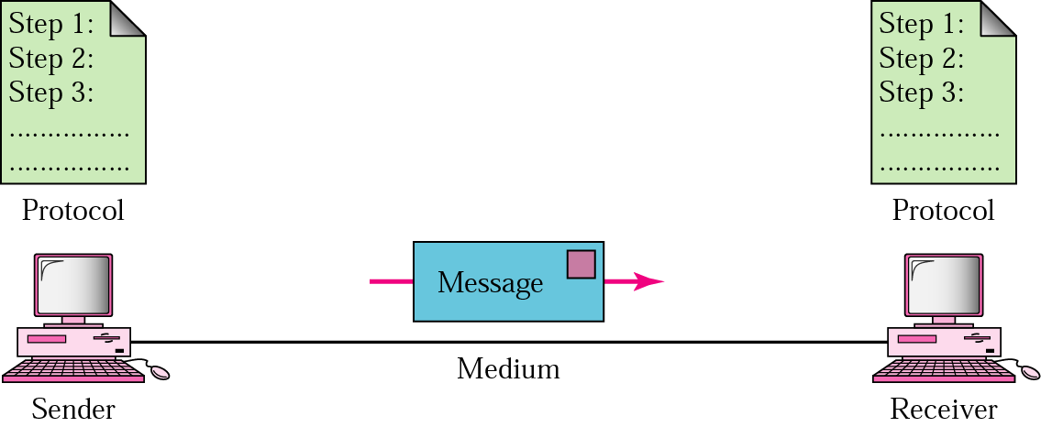
A data communication system
A sketch of the complete data communication system appears as shown below
DTE
DCE
Medium
DCE
DTE
Source
Interface
interface
Destination

Slide 12
A data communication system
A Data communication system is also viewed in a different way and will consist of the following components;
Message: The message is the information (data) to be communicated. Popular forms of information include text, numbers, pictures, audio, and video.
Sender/Source: The sender is the device that sends the data message. It can be a computer, workstation, telephone handset, video camera, and so on.

Slide 13
A data communication system
Transmitter: - A transmitter transforms and encodes the information in such a way as to produce electromagnetic signals that can be transmitted across some sort of transmission system. For example, a modem takes a digital bit stream from an attached device such as a personal computer and transforms that bit stream into an analog signal that can be handled by the telephone network.
Transmission medium: The transmission medium is the physical path by which a message travels from sender to receiver. Some examples of transmission media include twisted-pair wire, coaxial cable, fiber-optic cable, and radio waves.

Slide 14
A data communication system
Receiver: - The receiver accepts the signal from the transmission medium and converts it into a form that can be handled by the destination device. For example, a modem will 10 Data C Unit-1 Introduction to Data Communications accept an analog signal coming from a network or transmission line and convert it into a digital bit stream.
Destination: - Takes the incoming data from the receiver and can be any kind of digital equipment like the source.
Protocol: A protocol is a set of rules that govern data communications. It represents an agreement between the communicating devices.

Slide 15
Transmission methods - Parallel Transmission
Parallel transmission
  Each bit is sent over separate connections all the same time.
  It is the method employed within computers to interconnect components such as memory and the central processing unit.
  Tracks on a printed circuit board that constitute a parallel path for data transmission are referred to as a bus.

Slide 16
Transmission methods - Parallel Transmission
Advantages
  It is very fast
Limitations
  Devices operate at different speeds. E.g. the computer, which is electronic, is much faster than the printer is, which is electro-mechanical; it sends thousands in the time it takes a printer to print 1 character.
  The size and complexity of the cabling required.
  The cost - Power and material

Slide 17
Transmission Methods - Serial Transmission
It involves sending each bit of a data byte along a single connection (signal wire and ground), in sequence, bit by bit.
The parallel data used by source terminal equipment must be converted to serial form by a shift register before it can be transmitted.
Another shift register converts the serial data back to parallel form
Used for longer distances since it is less complex and cheaper.

Slide 18
Transmission Modes - Serial Transmission
Advantages
  Simple and easy to implement
  Cheap to implement.
Disadvantages
  Slower speed due to extra processes of parallel to serial and back.
  Extra information sent for control purposes.

Slide 19
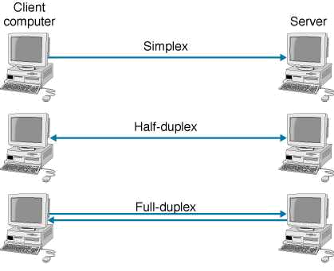
Data transfer modes

Slide 20
Data transfer modes
Any two devices communicate with each other by sending and receiving data. The data can flow between the two devices in the following ways. 1. Simplex 2. Half Duplex 3. Full Duplex
1. Simplex
In Simplex, communication is unidirectional. Only one of the devices sends the data and the other one only receives the data.
Example: in the above diagram: CPU send data while a monitor only receives data.

Slide 21
Data transfer modes
2. Half Duplex
In half duplex both the stations can transmit as well as receive but not at the same time.
When one device is sending other can only receive and vice-versa (as shown in figure above.)
Example: A walkie-talkie.
3. Full Duplex
In Full duplex mode, both stations can transmit and receive at the same time. Example: mobile phones

Slide 22
Standard codes
Digital data is not directly transmitted over transmission lines. It is first converted into a digital signal.
Digital signals are superior and are less prone to interference by noise in course of transmission over transmission lines.
Digital signals have high fidelity and also digital signals are transmitted faster than analogue signals.

Slide 23
Standard codes
The useful way to transmit data between digital equipment is by two-state electrical signals (0 and 1)
  For successful communication, both communicating devices must interpret codes in the same way – done by using a common code.
The most widely accepted code for alphanumeric characters is the ASCII (American Standard Code for Information Interchange).
ASCII uses 7 bit codes to represent alphanumeric characters.
  But 8 bits are normally transmitted with the eighth bit being used as a parity bit for error detection.

Slide 24
Standard codes
ASCII Converts all the characters used to represent information into numerical values, which are then converted to bits and finally signals.
IBM mainframe and peripheral equipment used EBCDIC (Extended Binary Coded Decimal Interchange Code).
  It uses all eight bits to define characters.
Digital conversions also need to be made for graphics, sounds, video and multimedia.
This digitized information is transmitted using serial or parallel transmission modes.

Slide 25
Other Data codes
Line transmission codes
Compression codes
Error detection and correction codes
Encryption codes

Slide 26
Line codes
When data is being transmitted over a transmission line, the data pulses are attenuated and interfered with by noise due to the nature of the transmission medium.
As a result the digital signal fades out. Not all digital signals have the same effect on the transmission medium.
Line transmission codes eliminate the DC components in digital signals thus making the line code more suitable for transmission over a medium.

Slide 27
Line codes
Line coding Mapping of binary information sequence into the digital signal that enters the channel
  Ex. “1” maps to +V square pulse; “0” to –V pulse
Line codes are bipolar signals carrying serial data.
They are chosen to suit the transmission system.
There has to be a synchronization of transmitter and receiver (synchronous systems).
The line code has to carry the equivalent of a clock, which the receiver has to extract from the data stream to tell it when to expect each bit.
  Transitions in the data stream are the key to this.

Slide 28
Line codes
Examples of line codes used are:-
Alternate Mark Inversion code – AMI
Non Return to Zero code – NRZ
Return to Zero code – RZ
Manchester code
High Density Bipolar 3rd Order code – HDB3, etc

Slide 29
Line codes- AMI
Alternate Mark Inversion is an example of bipolar encoding scheme
Three signal levels: {-V, 0, +V}
“1” maps to +V or –V in alternation
“0” maps to no pulse
String of 1s produces a square wave
Long string of 0s causes receiver to lose synch
Pseudoternary coding is another example of Bipolar encoding scheme. It does the opposite of AMI
“0” maps to +V or –V in alternation
“1” maps to no pulse

Slide 30
Line codes- AMI
Alternate Mark Inversion – AMI
A digital signal constitutes a series of 1s and 0s. The 1 represents instances in time when there is a signal pulse and the 0 represents instances in time when there is no signal pulse.
The instance when there is a signal pulse or 1 is called a Mark. The instance when there is no signal pulse or 0 is called a Space.
Thus a digital signal can also be represented as a series of Marks and Spaces.
In AMI alternate Marks are inverted.

Slide 31

Line codes- AMI
Example of AMI
A digital signal is of the format 01001100011. Convert the signal to AMI
Digital systems work in conjunction with a clock signal. Thus in reference to the clock signal the signal is a shown below:-

Slide 32
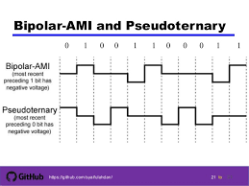
Bipolar AMI vs Pseudoternary

Slide 33
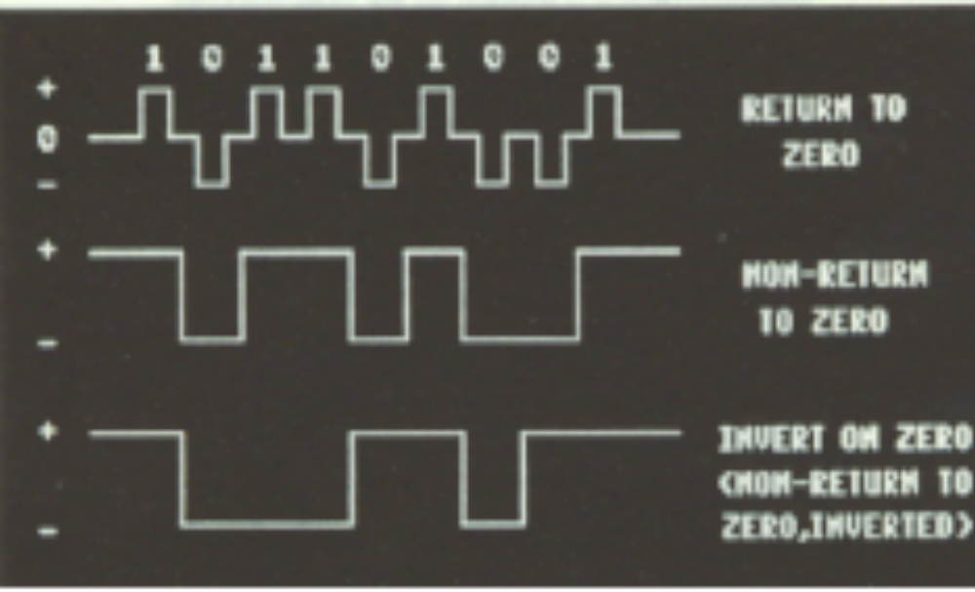
Line Codes-RZ, NRZ, NRZI

Slide 34
Line Codes-RZ
RZ (Return to zero)
  The voltage always returns to zero after each bit has been transmitted.
  Bit detection is easy. After a transition in the data stream another bit should be expected.

Slide 35
Unipolar & Polar Non-Return-to-Zero (NRZ)
1
0
1
0
1
1
1
0
0
Unipolar NRZ
Polar NRZ

Slide 36
Unipolar & Polar Non-Return-to-Zero (NRZ)
Unipolar NRZ
“1” maps to +A pulse and “0” maps to no pulse
High Average Power
Long strings of V or 0
  Poor timing
  Low-frequency content
Polar NRZ
“1” maps to +A/2 pulse and “0” maps to –A/2 pulse
Better Average Power
Long strings of +V/2 or –V/2
  Poor timing
  Low-frequency content

Slide 37
Line Codes-NRZ
NRZ (Non Return to Zero)
  Has fewer transitions than RZ (lower frequency) when delivering the same data.
  Data can be sent more quickly on the same channel.
  Problems arise when strings of 0’s and 1’s are transmitted since the line voltage appears as a DC level with no transition.
  This may result in loss of synchronization between transmitter and receiver leading to transmission errors in synchronous systems

Slide 38
Line Codes- NRZI
NRZI (Non Return to Zero Inverted)
  The invert on zero line code offers a solution to the NRZ problem when used with certain equipment.
  The voltage level changes only when 0 is transmitted and stays the same for 1.
  Transitions will always occur when transmitted data contains 0’s.
  Should long strings of 1’s occur, the transmitter inserts a 0 to ensure that there are always some level changes to maintain synchronization (bit stuffing). The receiver removes the stuffed 0 to return data to its original form (bit stripping). NRZI is used with HDLC protocols.

Slide 39
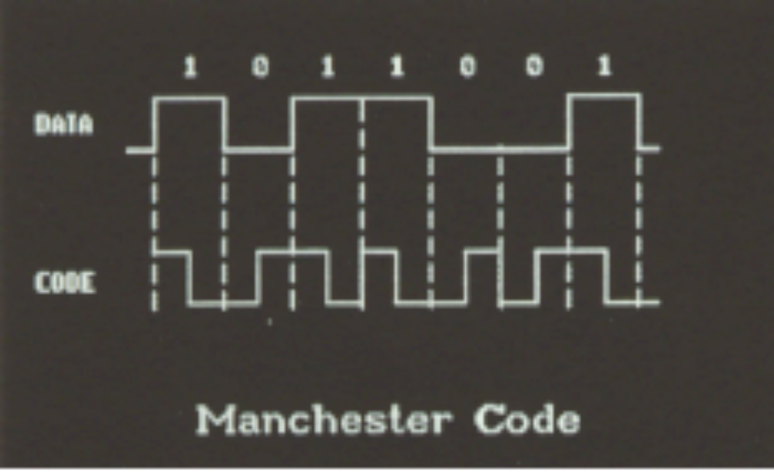
Line Codes- Manchester code

Slide 40
Line Codes- Manchester code
Manchester code- bipolar scheme
Manchester Encoding
1
0
1
0
1
1
1
0
0

Slide 41
Line Codes-Manchester code
Manchester code
  One data bit is replaced by two code bits to ensure that there is always transition in the middle of a data bit period
    0 is coded and transmitted as 01 and a data 1 as 10.
“1” maps into V/2 first T/2, -V/2 last T/2
“0” maps into -V/2 first T/2, V/2 last T/2
Every interval has transition in middle
This increases the number of transitions in the transmitted signal and there is no DC component. The recovery of the clock is simplified.
Simple to implement
Used in 10-Mbps Ethernet & other LAN standards

Slide 42
Degradation of signals
Whichever line code used, the data signal will be degraded during long distance communication owing to imperfections of the transmission medium used.
This is by being
  Attenuated: Get smaller
  Distorted: Misshapen
  Noise: Picking up noise along the way.
The receiver may be unable to differentiate between 0’s and 1’s.
  More marked when data is transmitted at high speeds.
  Limits the Maximum distance we can send signals.

Slide 43
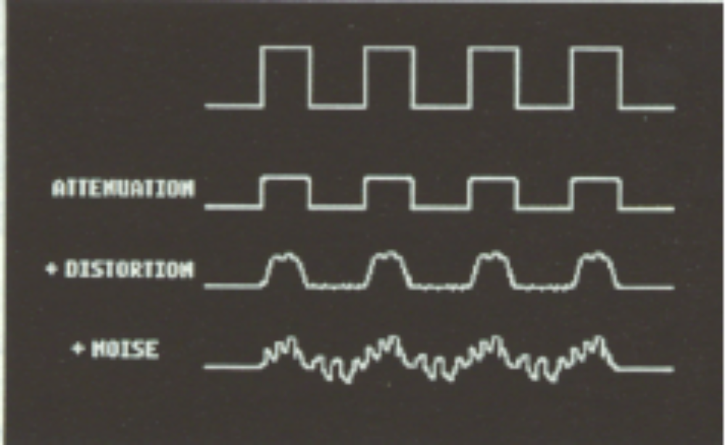
Degradation of signals

Slide 44
Data compression codes
Data can be compressed to economize on the transmission channel capacity and storage media.
Data compression can be lossless or lossy.
Lossy data compression techniques result in data loss during compression. Lossless data compression techniques result in no data loss during compression.
To economize on the channel capacity, data is usually compressed at the source by removing redundancy. At the destination the data is decompressed or redundancy is added to restore the original data before transmission.
An example of a compression code is Runlength
For example, if the input string is “wwwwaaadexxxxxx”, then the function should return “4w3a1d1e6x” i.e. send 10 symbols instead of 15

Slide 45
Error Detection and Correction Codes
When data is transmitted through a media, it is interfered with by noise and other transmission media characteristics.
The data will have errors or corrupted at the receive end.
Applications require certain reliability level
  Data applications require error-free transfer
  Voice & video applications tolerate some errors
In case data is changed, the error detection and correction codes have a mechanism of detecting and correcting the corrupted bits in the message.
Error control ensures a data stream is transmitted to a certain level of accuracy despite errors
Examples of codes include parity and linear block codes.

Slide 46
Error Detection and Correction Codes
Single Parity Check
Append an overall parity check to k information bits
All codewords have even # of 1s
Receiver checks to see if # of 1s is even
  All error patterns that change an odd # of bits are detectable
  All even-numbered patterns are undetectable
Parity bit used in ASCII code
Eg. 1001011 will be 10010110 for even parity and 10010111 for odd parity
Info Bits: b₁, b₂, b₃, …, b_{k}
Check Bit: b_{k+1}= b₁+ b₂+ b₃+ …+ b_{k} modulo 2
Codeword: (b₁, b₂, b₃, …, b_{k,}, b_{k+1})

Slide 47
Encryption Codes
In data communications security and privacy are essential. Data encryption codes are used to secure data and institute the required privacy in data.
These codes are used to encipher data so that data cannot be tampered with or sniffed during transmission over communication channels.
Suitable algorithms are developed to encipher data at the source and decipher data at destination.
Examples of encryption algorithms are International Data Encryption Algorithm (IDEA), Data Encryption Standard (DES), Rivest Shamir Adleman (RSA), Caesar Shift, Enigma machine

